Slide 1
Making Recommendations: Content Filtering Collaborative Filtering Latent Factors
Jay Urbain, Ph.D.
Electrical Engineering and Computer Science Department
Milwaukee School of Engineering
Credits: See last page with references

Slide 2
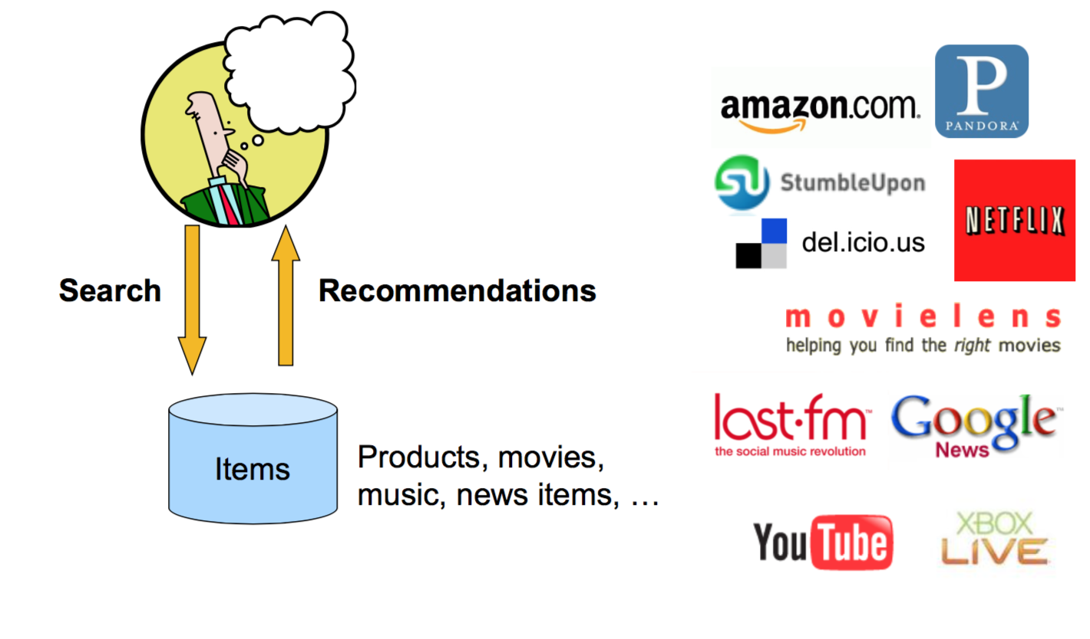
Recommendations

Slide 3
From scarcity to abundance
Shelf space is a scarce commodity for traditional retailers
Also: TV networks, movie theaters,...
The web enables near zero-cost dissemination of information about products
From scarcity to abundance
Gives rise to the “Long Tail” phenomenon (Wired)

Slide 4
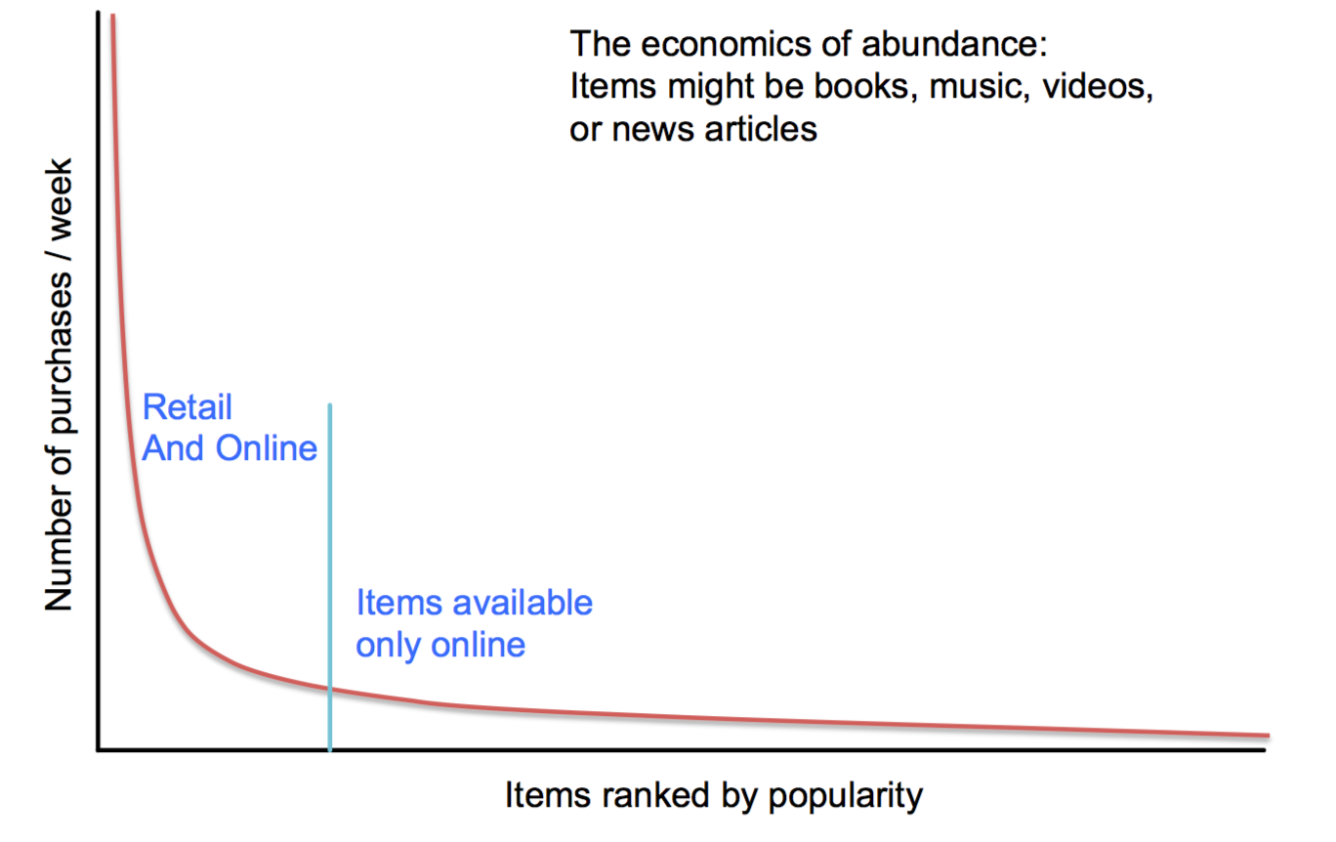
Long Tail

Slide 5
Long Tail
More choice necessitates better filters
Recommendation engines
How Into Thin Air made Touching the Void a bestseller (http://www.wired.com/wired/archive/12.10/tail.html )
Examples
Books, movies, music, new car sales, medical treatments
People (friend recommendations on Facebook, LinkedIn, and Twitter)

Slide 6
Types of recommendations
Editorial and hand curated
List of favorites
Lists of “essential” items
Simple aggregates
Top 10, Most Popular, Recent Uploads
Tailored to individual users
Amazon, Netflix, Pandora ...
Our focus here

Slide 7
Recommendation Model
C = set of Customers
S = set of Items
Utility function u: C × S àR
R = set of ratings
R is a totally ordered set, e.g., 0-5 stars, real number in [0,1]

Slide 8
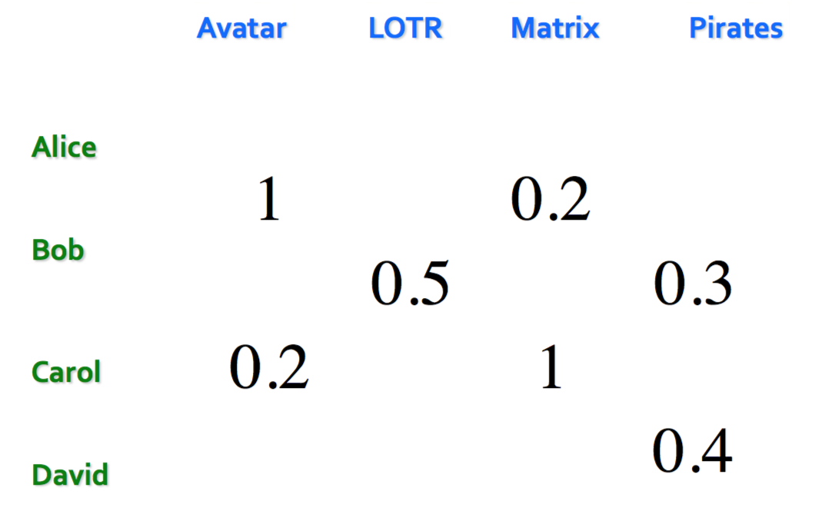
Utility Matrix

Slide 9
Problems
Gathering “known” ratings for matrix
How to collect the data in the utility matrix
Extrapolate unknown ratings from the known ones
Mainly interested in high unknown ratings
Not typically interested in knowing what you don’t like but what you like
Evaluating extrapolation methods
How to measure success/performance of recommendation methods

Slide 10
Gathering Ratings
Explicit
Ask people to rate items
Doesn’t scale: only a small fraction of users leave ratings and reviews
Implicit
Learn ratings from user actions
E.g., purchase implies high rating
What about low ratings?

Slide 11
Extrapolating Utilities
Key problem: matrix U is sparse
Most people have not rated most items
Cold start:
New items have no ratings
New users have no history
Three approaches to recommender systems
Content-based
Collaborative
Latent factor based

Slide 12
Content-based
Main idea: Recommend items to customer x similar to previous items rated highly by x
Examples:
Movies
Same actor(s), director, genre, ...
Websites, blogs, news
Articles with “similar” content
People
Recommend people with many common friends

Slide 13
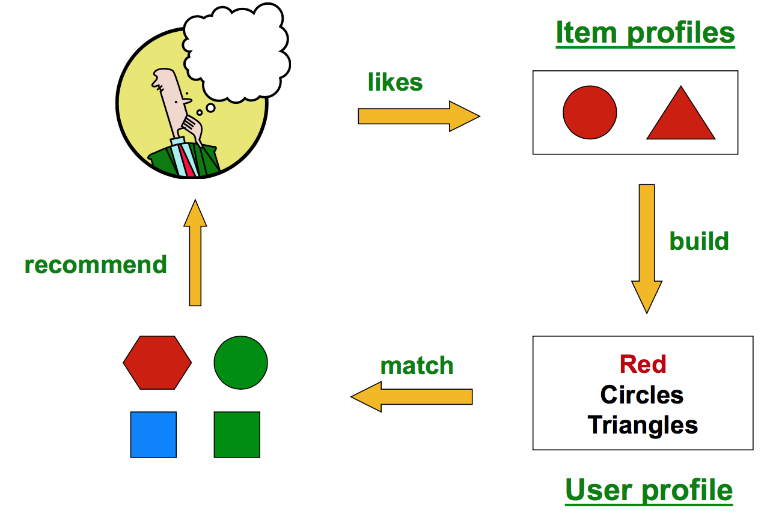
Build item profiles, make recommendations from profile

Slide 14
Item profiles
For each item, create an item profile
Profile is a set of features
Movies: author, title, actor, director,...
Images, videos: metadata and tags
People: Set of friends
Think of the item profile as a feature vector
One attribute per feature per item (e.g., each actor, director,...)
Vector might be boolean or real-valued or mix
Predict how similar any item is to any other item

Slide 15
User profiles
User has rated items with profiles i₁,...,i_{n}
Simple: (weighted) average of rated item profiles
Variant: Normalize weights using average rating of user
More sophisticated aggregations possible – learn feature weights.

Slide 16
Example 1: Boolean Utility Matrix
Items are movies, only feature is “Actor”
Item profile: vector with 0 or 1 for each Actor
Suppose user x has watched 5 movies
2 movies featuring actor A
3 movies featuring actor B
User profile = mean of item profiles
Feature A’s weight = 2/5 = 0.4
Feature B’s weight = 3/5 = 0.6

Slide 17
Example 2: Star Ratings
Same example, 1-5 star ratings
Actor A’s movies rated 3 and 5
Actor B’s movies rated 1, 2 and 4
Useful step: Normalize ratings by subtracting user’s mean rating (mean=3)
Actor A’s normalized ratings = 0, +2
Profile weight = (0 + 2)/2 = 1
Actor B’s normalized ratings = -2, -1, +1
Profile weight = -2/3

Slide 18
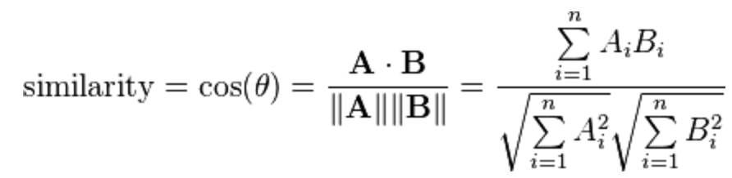
Making Predictions
User profile x, Item profile I
Estimate U(x,i) = cos(θ) = (x . i)/(|x||i|)
Or other similarity measurement

Slide 19
Pros: Content-based approach
No need for data on other users
Able to recommend to users with unique tastes
Able to recommend new & unpopular items
No first-rater problem
Explanations for recommended items
Content features that caused an item to be recommended

Slide 20
Cons: Content-based approach
Finding the appropriate features is hard
E.g., images, movies, music
Overspecialization
Never recommends items outside user’s content profile
People might have multiple interests
Unable to exploit quality judgments of other users
Cold-start problem for new users
How to build a user profile?

Slide 21
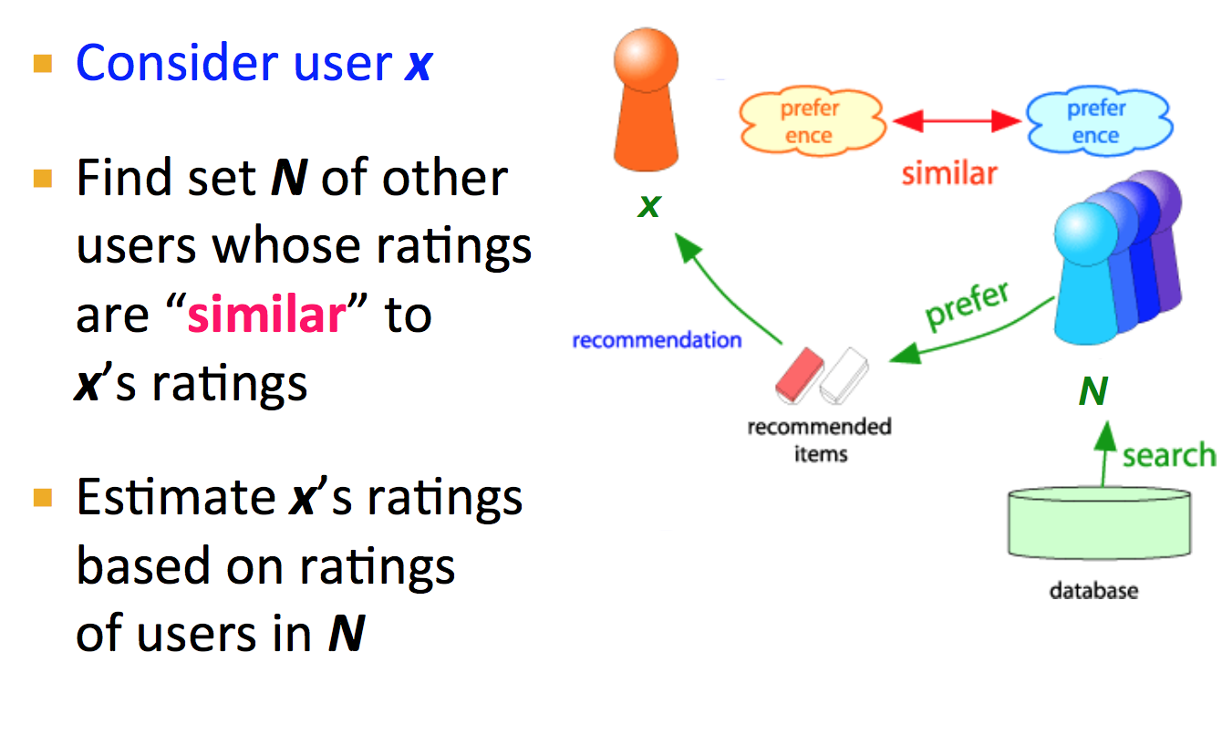
Collaborative Filtering

Slide 22
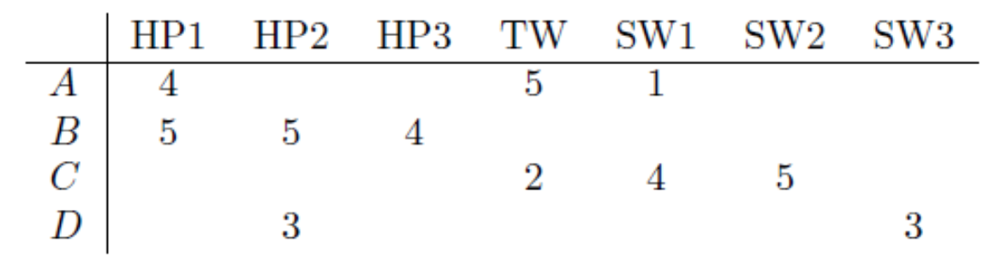
Similar Users
Consider users x and y with rating vectors r_{x} and r_{y}
We need a similarity metric sim(x, y)
Capture intuition that sim(A,B) > sim(A,C)

Slide 23
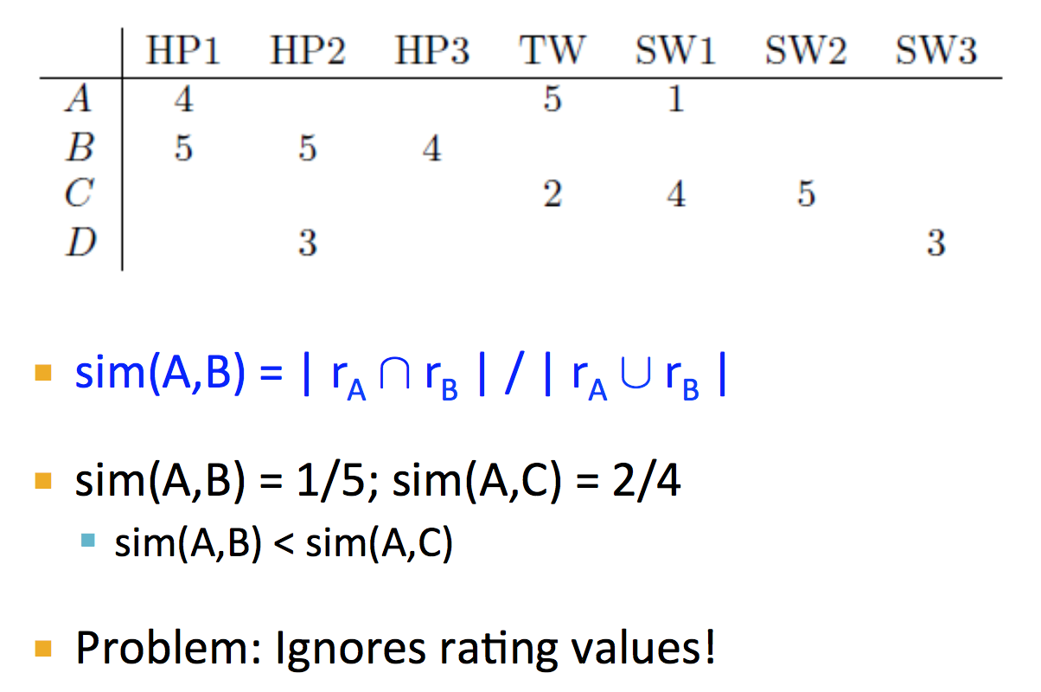
Jaccard Similarity

Slide 24
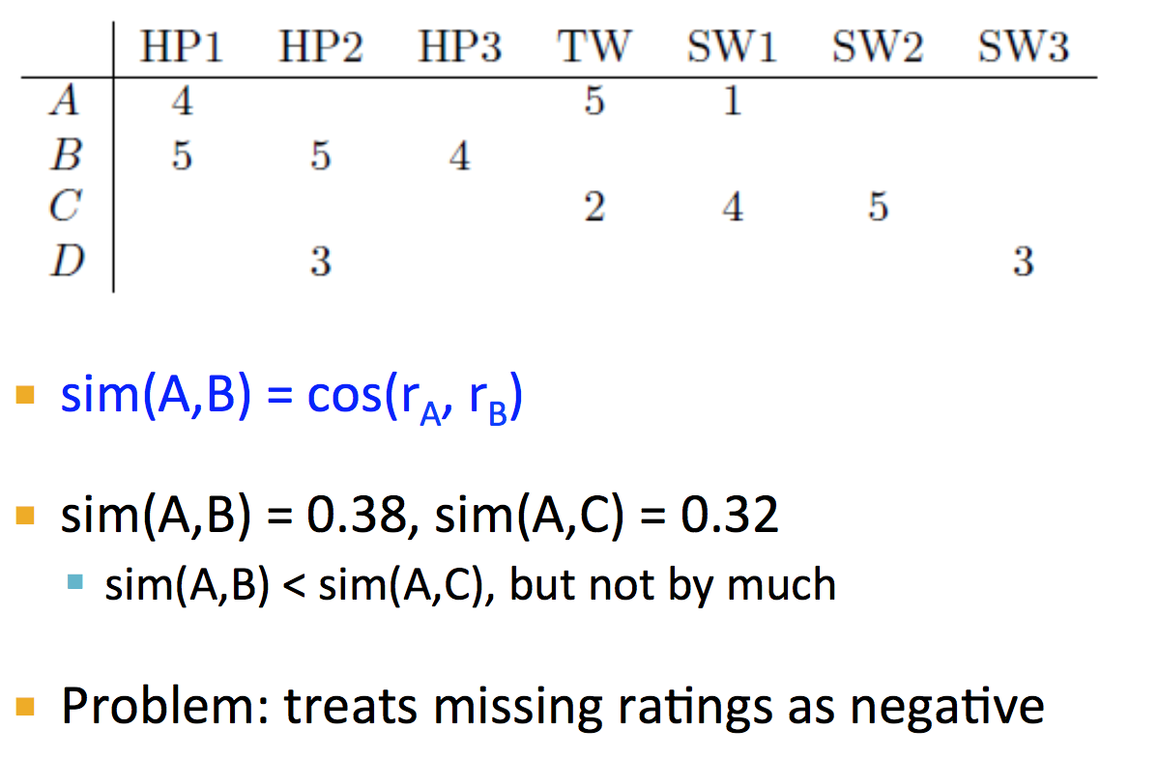
Cosine Similarity

Slide 25
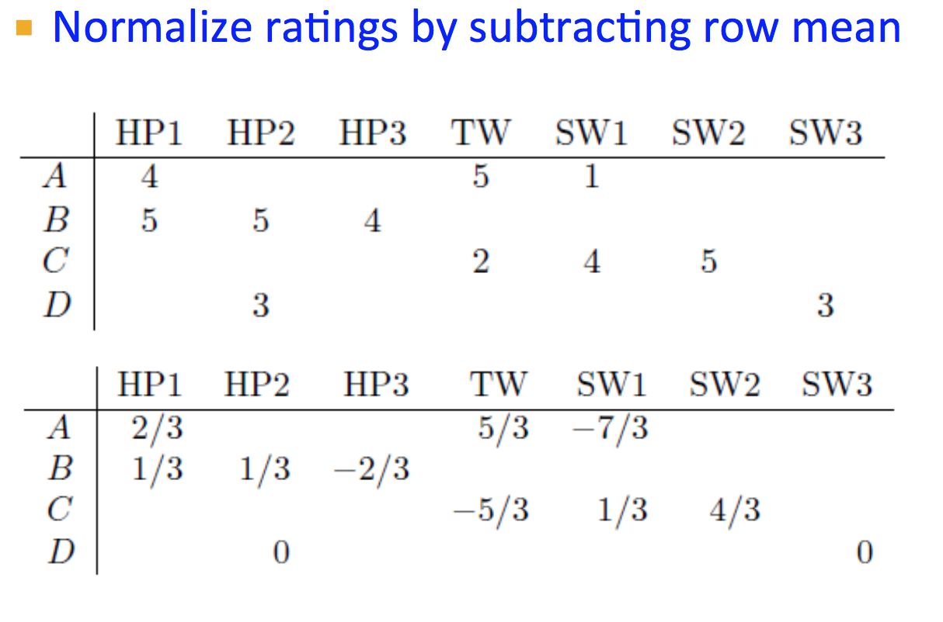
Centered Cosine – Pearson Correlation Coefficient

Slide 26
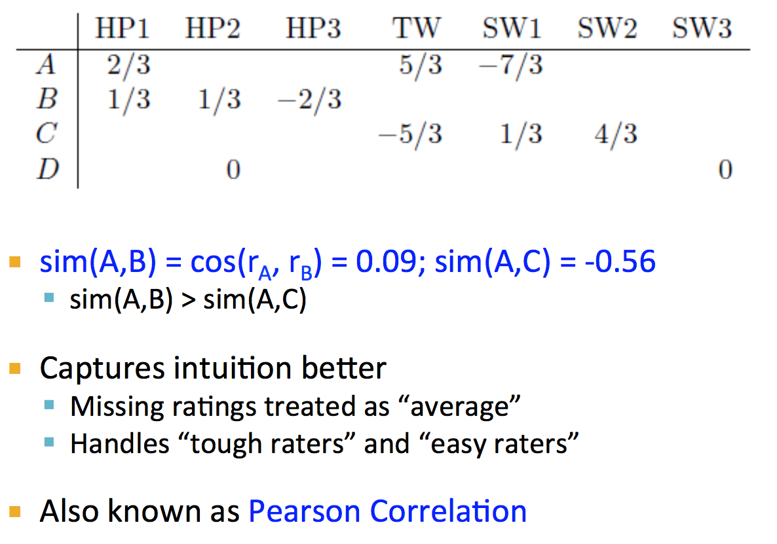
Centered Cosine

Slide 27
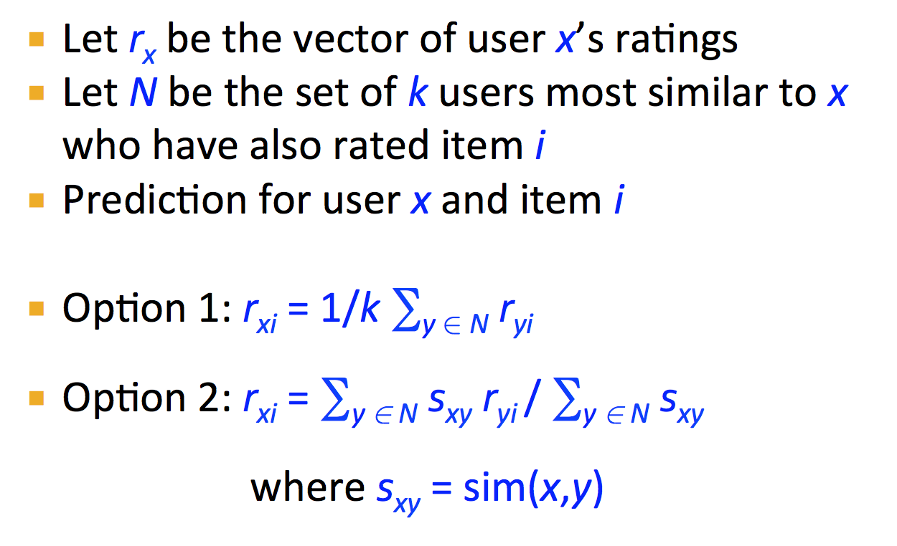
Rating Predictions

Slide 28
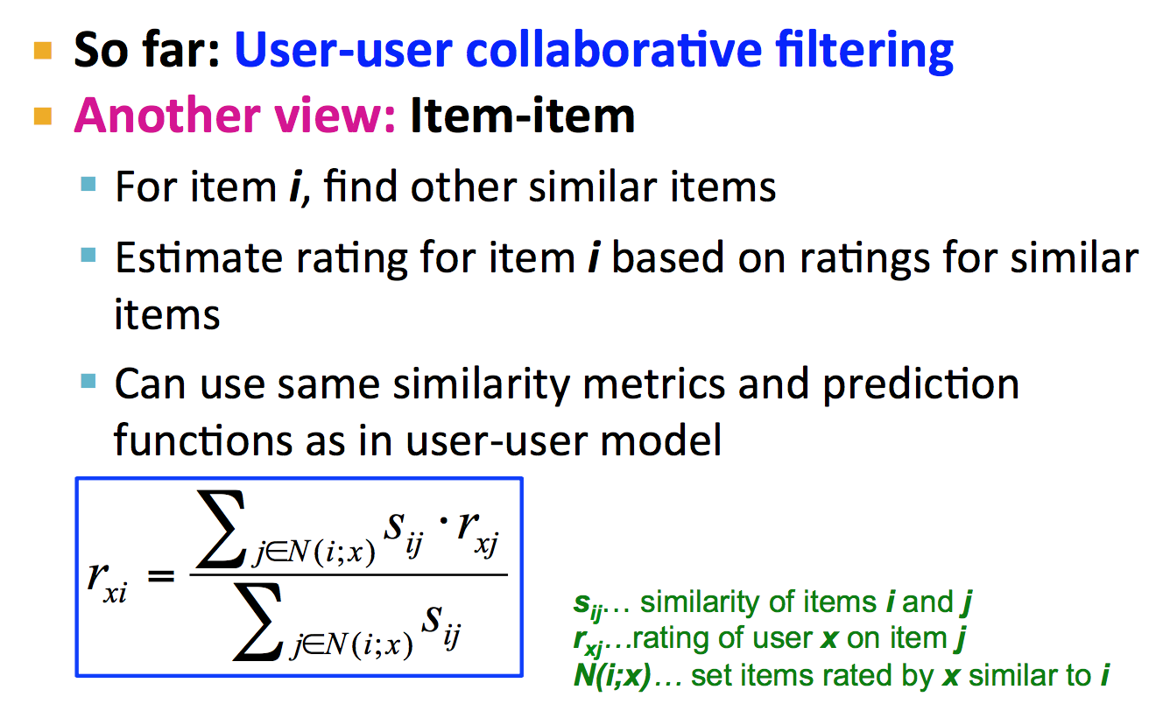
Item-Item Collaborative Filtering

Slide 29
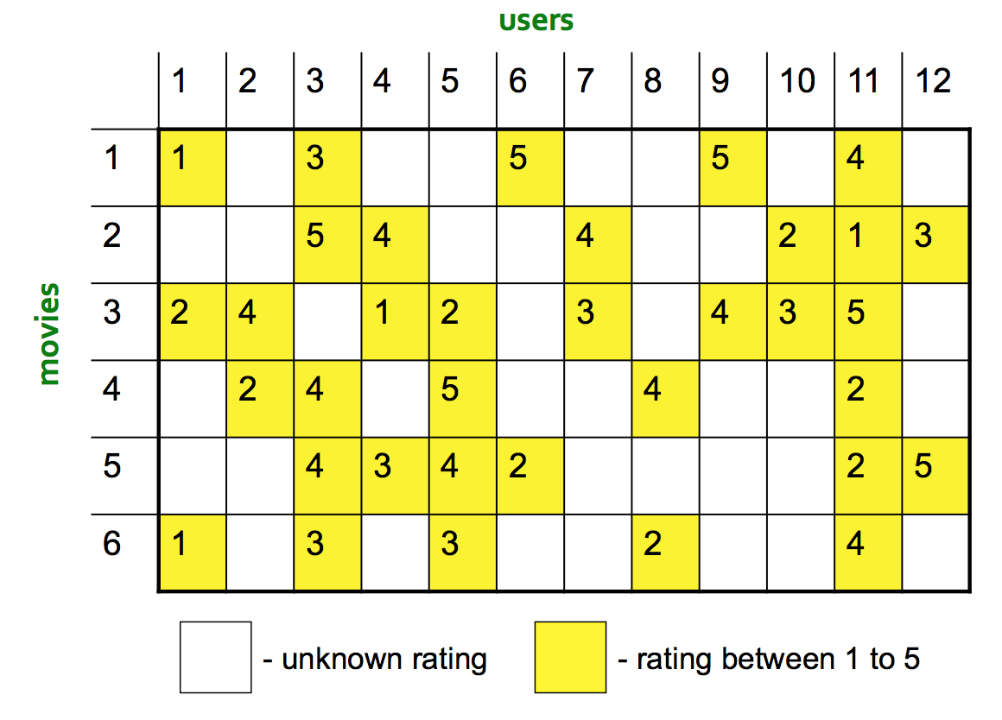
Item-Item CF (n=2)

Slide 30
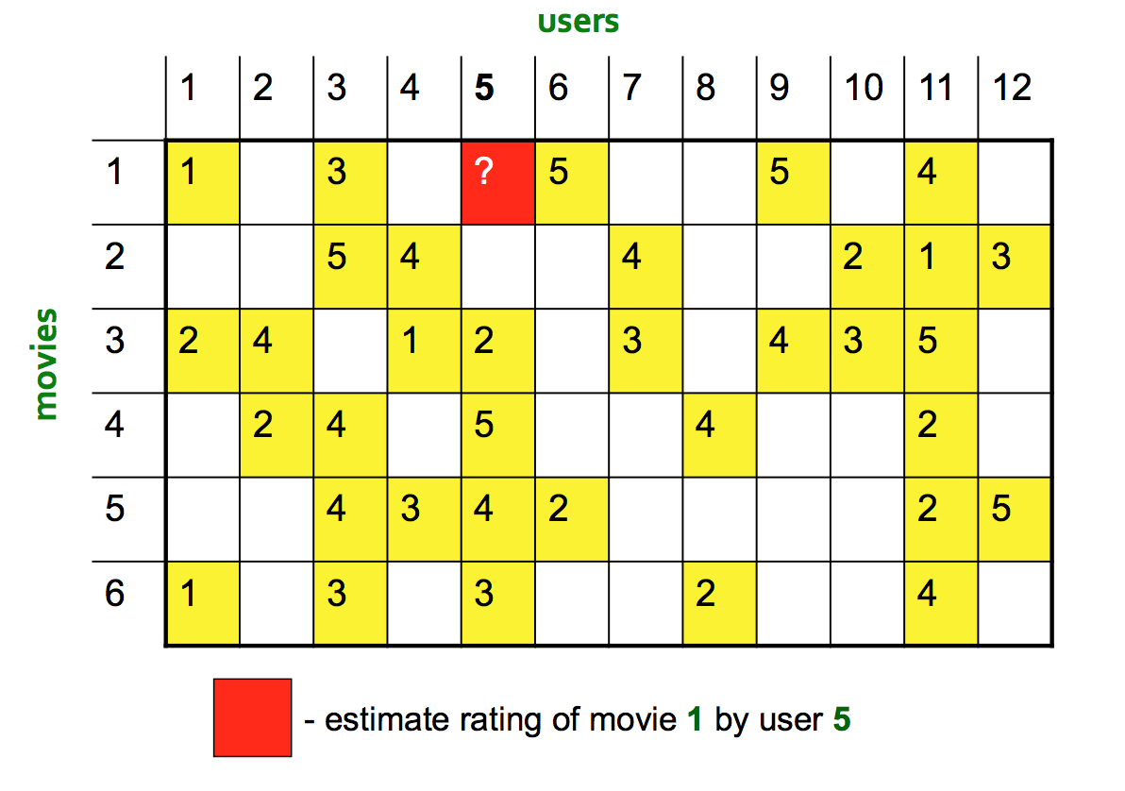
Item-Item CF (n=2)

Slide 31
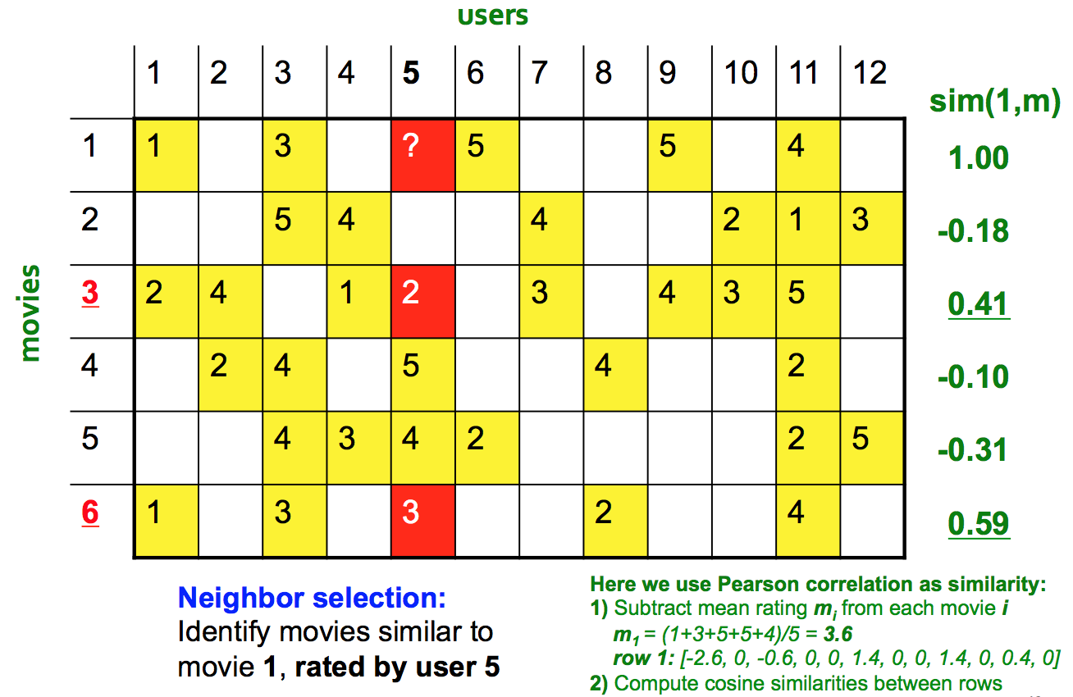
Item-Item CF (n=2)

Slide 32
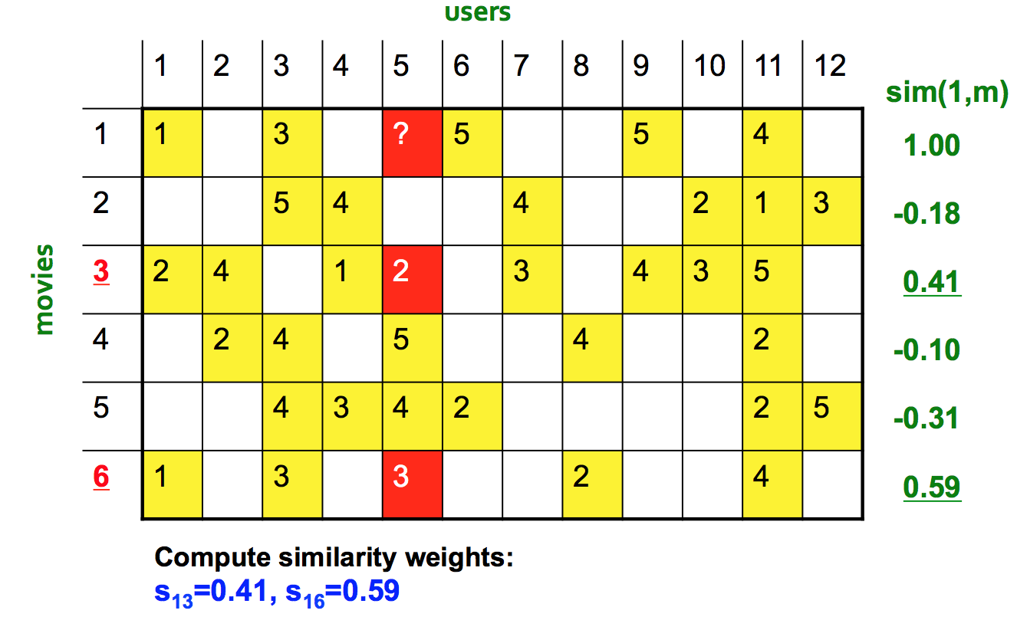
Item-Item CF (n=2)

Slide 33
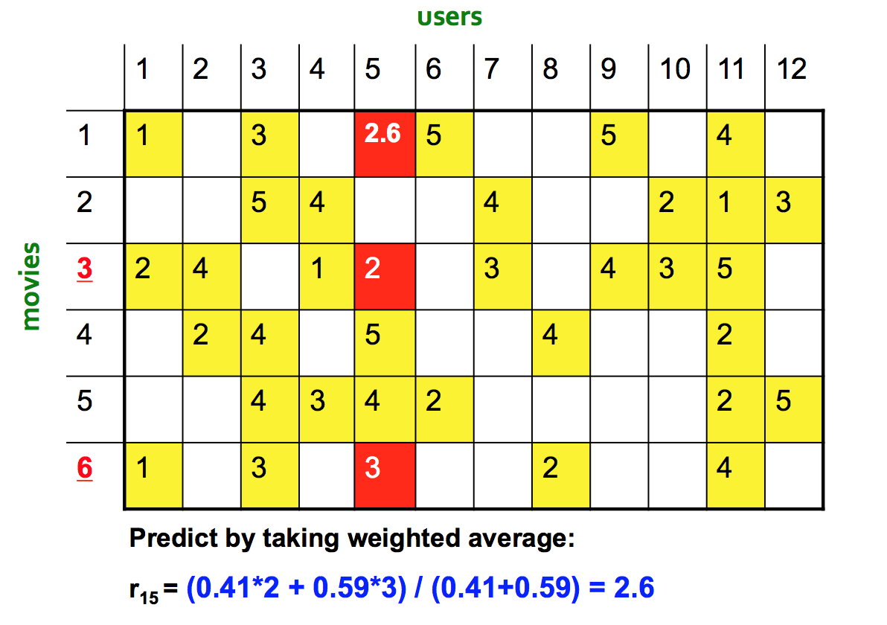
Item-Item CF (n=2)

Slide 34
Item-item vs. User-user
In theory, user-user and item-item are dual approaches
In practice, item-item outperforms user-user in many use cases
Items are “simpler” than users
Items belong to a small set of “genres”, users have varied tastes
Item Similarity is more meaningful than User Similarity

Slide 35
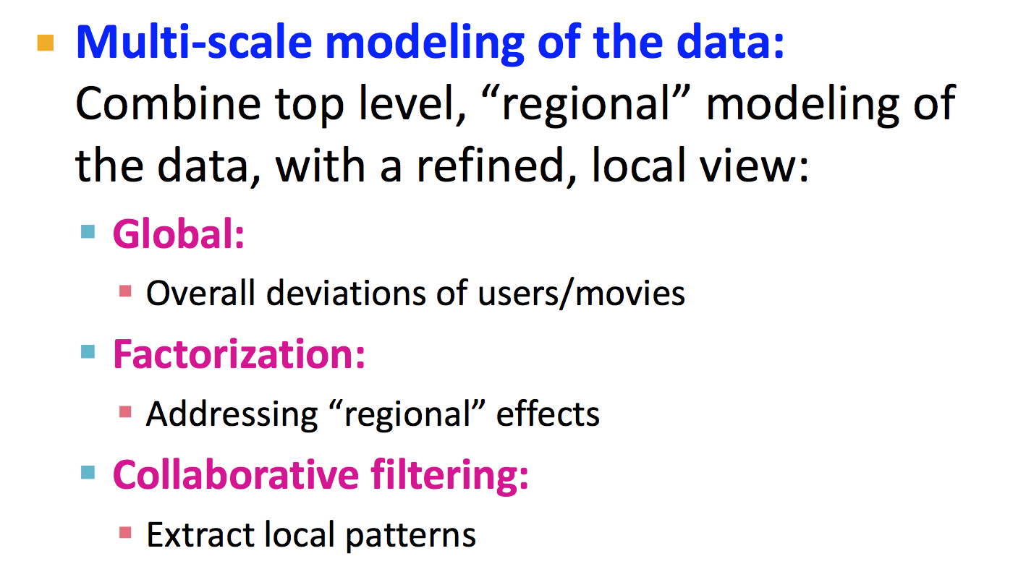
Modern Recommendation System

Slide 36
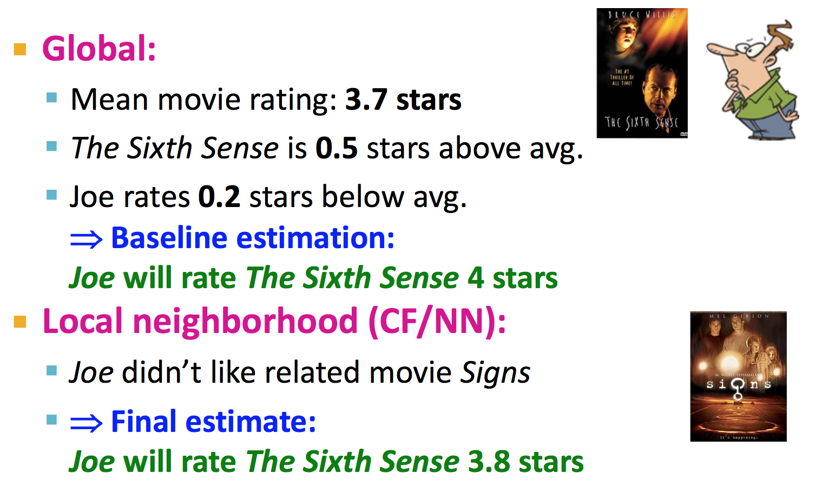
Modeling Local & Global Effects

Slide 37
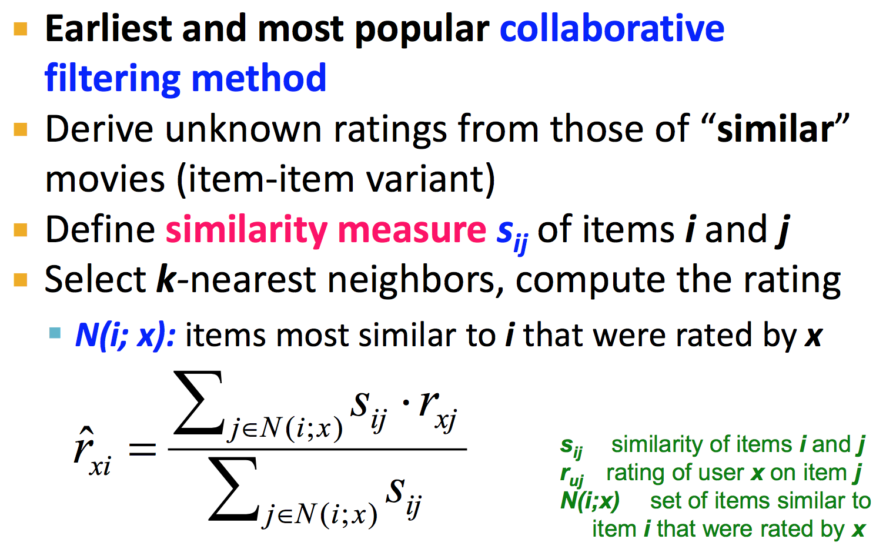
Recap: CF

Slide 38
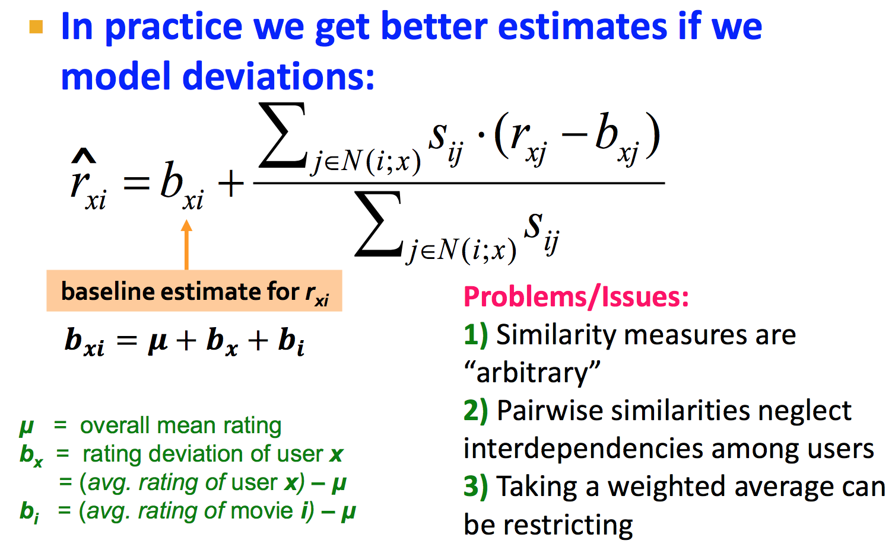
Modeling Local & Global Effects

Slide 39
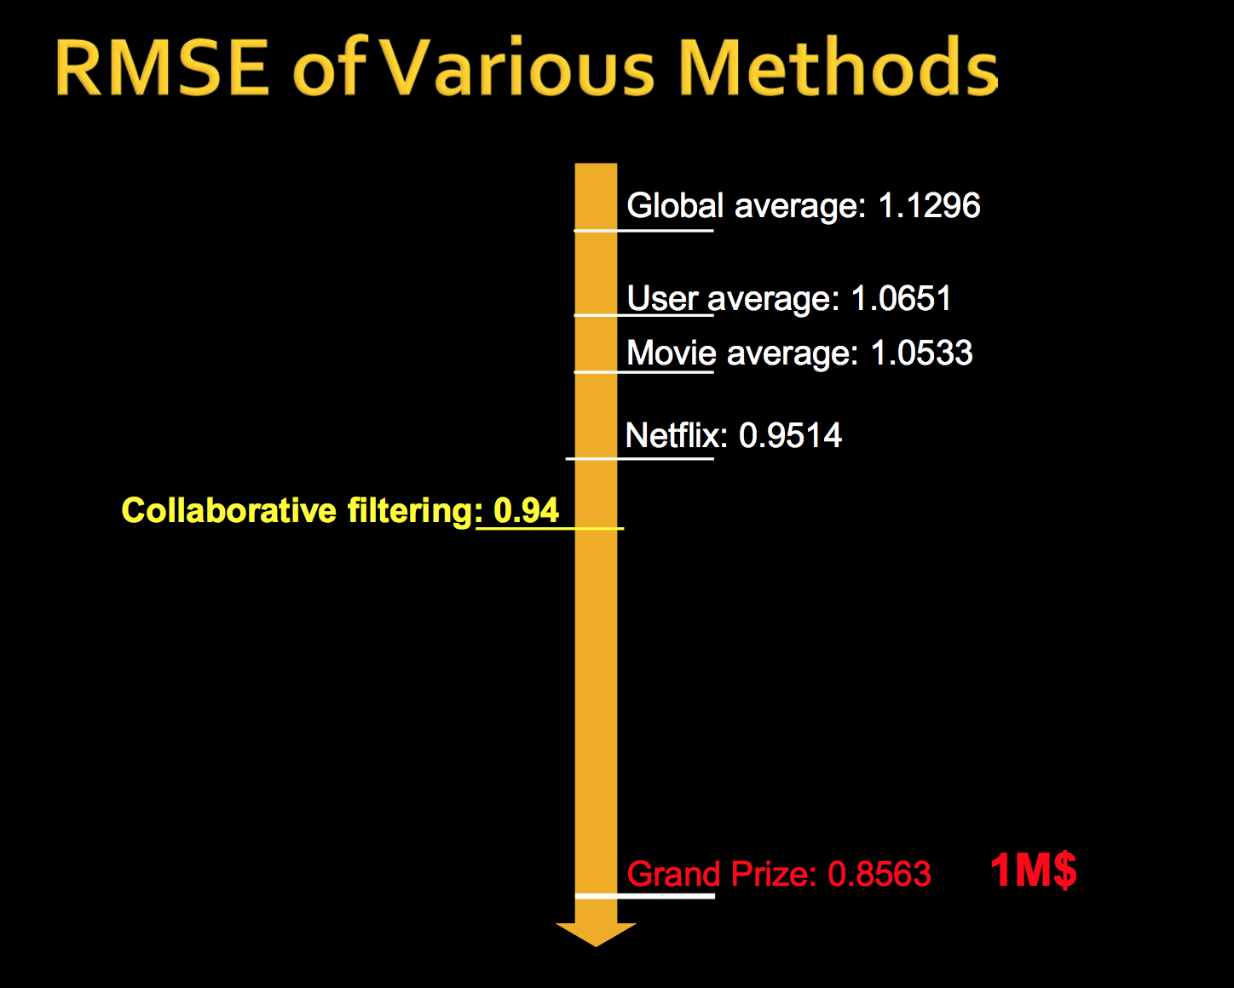

Slide 40
STOP

Slide 41
What does it mean to learn?
Improve our performance by interacting with our environment.
Build model of the world we interact with to improve future performance – prediction.
Confabulation - human brain is constantly deciding among multiple competing predications.
In what ways do we interact with our environment to learn?
Read
Watch
Hear
???

Slide 42
Learning
We often learn by interacting with each other.
Common insight: personal tastes are correlated.
If Alice and Bob both like X, and Alice likes Y then Bob is more likely to like Y.
Especially (perhaps) if Bob knows Alice. Or Bob and Alice like other similar things.

Slide 43
Collective Intelligence
Can we model these interactions? Sure!
Google
Amazon
Netflix
Pandora
Futures markets
All of these organizations combine the behavior, preferences, or ideas of a group of people to create novel insights.

Slide 44
Collective Intelligence
Collecting answers from a large group of people lets you draw statistical conclusions about the group that no individual member would have known by themselves.
Building new conclusions from independent contributors is what collective intelligence is all about.
So how do we go about doing that?
Collaborative Filtering, Content Filtering, Collaborative + Content Filtering

Slide 45
Content filtering

Slide 46
Collaborative Filtering
What is the low-tech way to get recommends for products, movies , interesting web sites, or entertaining things to do?

Slide 47
Collaborative Filtering
What is the low-tech way to get recommendations for products, movies , interesting web sites, or entertaining things to do?
Collective Intelligence - ask your friends!
Do some of your friends have better taste than others?
These friends are more likely to influence our decisions.
Collaborative filtering - recommend items based on similarity measures between users and/or items.

Slide 48
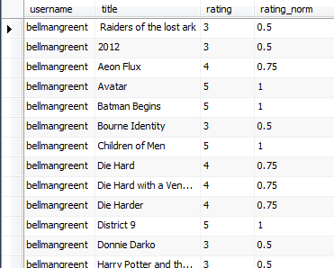
Collaborative Filtering
Lets say we want to use the combined “wisdom” of an extended group of friends to pick movies.
Collect preferences
Use the Web
Build a database of individual ratings on movies

Slide 49
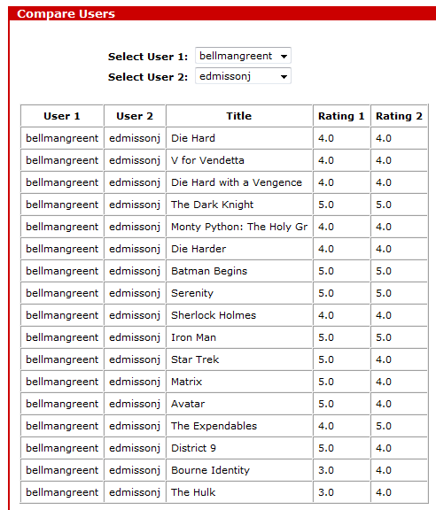
Collaborative Filtering
Finding similar users
Need method for correlating choices:
Euclidian Distance
Pearson Correlation
Singular Value Decomposition
Clustering
Classification

Slide 50
Finding similar users – Euclidean

Slide 51
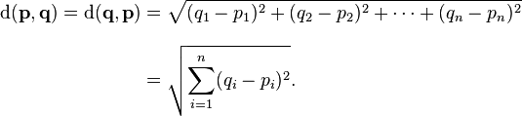
Collaborative Filtering
Finding similar users – Euclidian Distance
Take the differences in each axis
Square them & add them together
Then take the square root of the sum
select sqrt(sum( pow(r1.rating_norm-r2.rating_norm,2))) as sc
Bellmangreent edmissonj 0.535898384862245
bellmangreent bellmangreent 1.00
Problems with Euclidean distance?

Slide 52
Collaborative Filtering
Finding similar users –
Euclidian is just an absolute distance measure
Correlation is a measure of how well two sets of data fit on a straight line, i.e., relative strength of association.
Corrects for “grade inflation”
Remove consistent differences

Slide 53
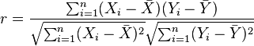
Collaborative Filtering
Finding similar users –
Pearson (product-moment) correlation coefficient
Measure of the correlation (linear dependence) between two variables X and Y, given a value between +1 and −1 inclusive.
Defined by the covariance of the two variables divided by the product of their standard deviations.
Corresponds to the cosine of the angle between two regression lines.

Slide 54
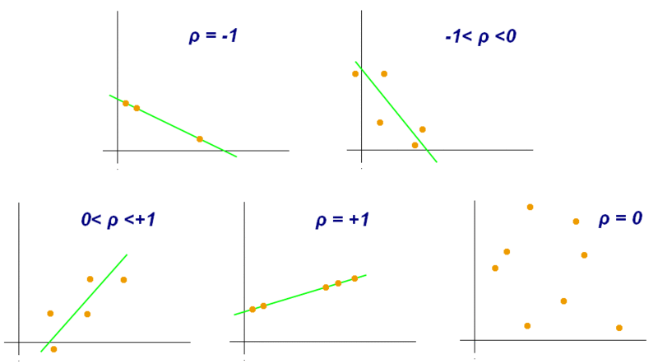
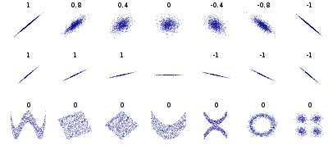
Collaborative Filtering
Pearson correlation coefficient
different values of correlation coefficient (ρ)
the correlation reflects the non-linearity and direction of a linear relationship (top row), but not the slope

Slide 55
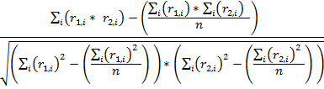
Collaborative Filtering
Finding similar users – Pearson Correlation Coefficient
( sum(r1.rating_norm*r2.rating_norm) - (sum(r1.rating_norm)*sum(r2.rating_norm))/count(*) ) /
sqrt( ( sum(pow(r1.rating_norm,2))-(pow(sum(r1.rating_norm),2)/count(*)) ) * ( sum(pow(r2.rating_norm,2))-(pow(sum(r2.rating_norm),2)/count(*)) ) ) as sc
Mean of products formulation
STDEV r1
STDEV r2

Slide 56
Finding similar users – Normalized (Pearson Correlation Coefficient)

Slide 57
Collaborative Filtering
Ranking the reviewers
Now that we can compare any two people.
Score everyone against a given person and find the closest matches.
Allows us to find the reviewers whose taste are most similar to any individual.

Slide 58
Collaborative Filtering
Ranking the reviewers
# create a correlation coefficient similarity table
insert into sim
select u1.userid as userid1, u2.userid as userid2,
( sum(r1.rating_norm*r2.rating_norm) - (sum(r1.rating_norm)*sum(r2.rating_norm))/count(*) ) /
sqrt( ( sum(pow(r1.rating_norm,2))-(pow(sum(r1.rating_norm),2)/count(*)) ) * ( sum(pow(r2.rating_norm,2))-(pow(sum(r2.rating_norm),2)/count(*)) ) )
as sc
from ratings r1, ratings r2, users u1, users u2, movies m
where r1.userid=u1.userid
and r2.userid=u2.userid
and r1.itemid=r2.itemid
and r1.itemid=m.movieid
and u1.username<>u2.username
group by u1.username, u2.username
order by u1.username, sc desc;

Slide 59
Collaborative Filtering
Ranking the reviewers
# rank the reviewers
select x.username1, max(x.sc) as maxsc
from (
select u1.username as username1, u2.username as username2, s.sc
from sim s, users u1, users u2
where s.userid1=u1.userid
and s.userid2=u2.userid) x
group by x.username1
order by maxsc;

Slide 60
Collaborative Filtering
4. Recommending Items
Using the correlation coefficient that ranks users with respect to each other.
Use this score to rank products.
# Finally! Make recommendations for a given user!
select u1.username, m.title, sum( r.rating_norm*s.sc ) / sum(s.sc) rating
from ratings r, users u1, users u2, movies m, sim s
where r.userid=u2.userid
and r.itemid=m.movieid
and s.userid1=u1.userid
and s.userid2=u2.userid
and u1.username='breuerr'
and r.itemid not in (
select r.itemid
from users u, ratings r
where r.userid=u.userid
and u.username='breuerr'
)
group by m.title
order by rating desc;

Slide 61
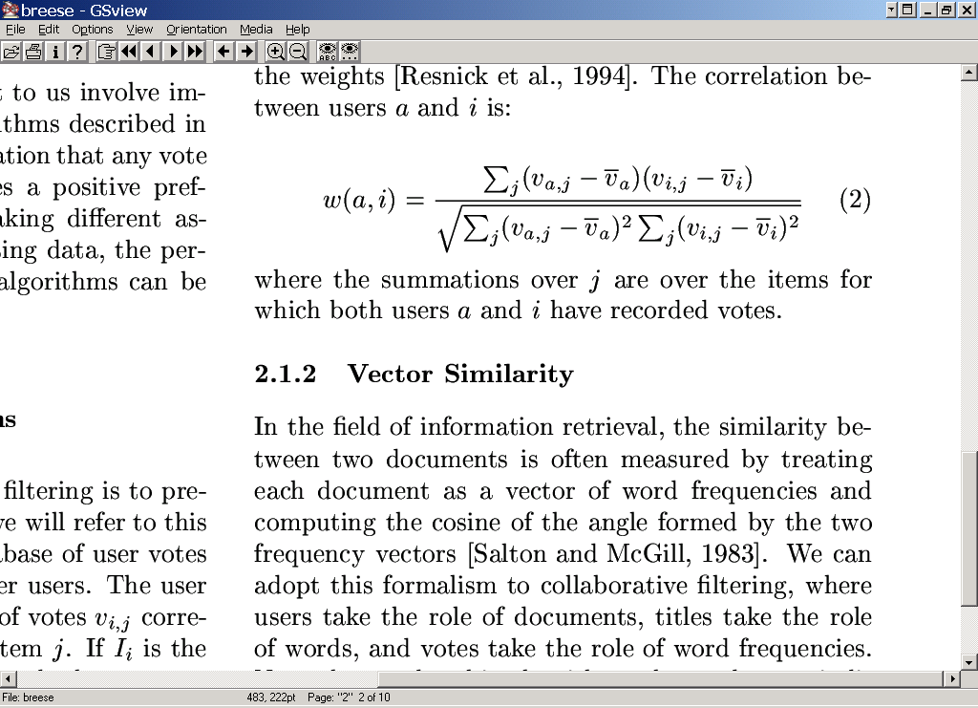
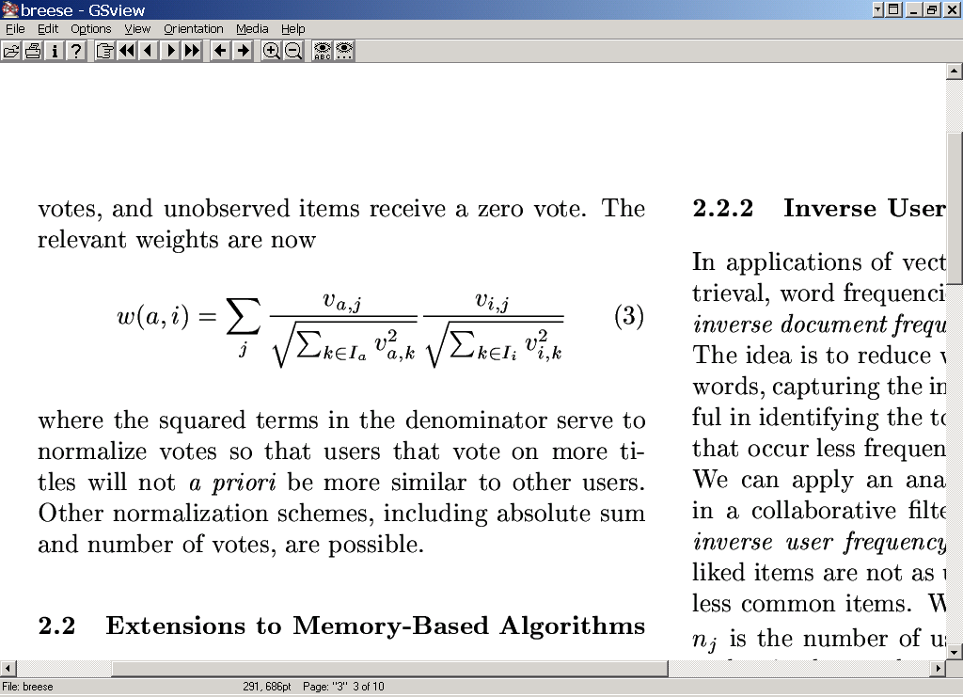
Algorithms for Collaborative Filtering 1: Memory-Based Algorithms (Breese et al, UAI98)
K-nearest neighbor
Pearson correlation coefficient (Resnick ’94, Grouplens):
Cosine distance (from IR)

Slide 62
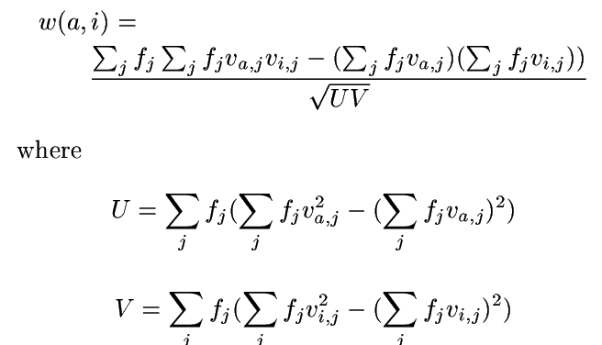
Algorithms for Collaborative Filtering 1: Memory-Based Algorithms (Breese et al, UAI98)
Cosine with “inverse user frequency” f_{i} = log(n/n_{j}), where n is number of users, n_{j} is number of users voting for item j

Slide 63
LIBRA Book Recommender
Content-Based Book Recommending Using Learning for Text Categorization. Raymond J. Mooney, Loriene Roy, Univ Texas/Austin; DL-2000
[CF] assumes that a given user’s tastes are generally the same as another user ... Items that have not been rated by a sufficient number of users cannot be effectively recommended. Unfortunately, statistics on library use indicate that most books are utilized by very few patrons. ... [CF] approaches ... recommend popular titles, perpetuating homogeneity.... this approach raises concerns about privacy and access to proprietary customer data.

Slide 64
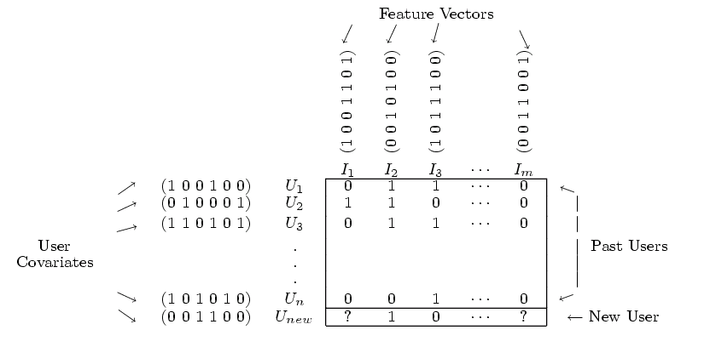
Collaborative + Content Filtering (Basu et al, AAAI98; Condliff et al, AI-STATS99)
Use your classification algorithm of choice

Slide 65
Content Filtering (Basu et al, AAAI98; Condliff et al, AI-STATS99)
Engineer features for content filtering,
Integrate within ensemble method with
Collaborative filtering
 |  | Airplane | Matrix | Room with a View | ... | Hidalgo
 |  | comedy | action | romance | ... | action
Joe | 27,M,70k | 9 | 7 | 2 |  | 7
Carol | 53,F,20k | 8 |  | 9
...
Kumar | 25,M,22k | 9 | 3 |  |  | 6
U_{a} | 48,M,81k | 4 | 7 | ? | ? | ?

Slide 66
Collaborative + Content Filtering As Classification (Basu et al, AAAI98)
genre={romance}, age=48, sex=male, income=81k, usersWhoLikedMovie={Carol}, moviesLikedByUser={Matrix,Airplane}, ...
genre={action}, age=48, sex=male, income=81k, usersWhoLikedMovie = {Joe,Kumar}, moviesLikedByUser={Matrix,Airplane},...
 |  | Airplane | Matrix | Room with a View | ... | Hidalgo
 |  | comedy | action | romance | ... | action
Joe | 27,M,70k | 1 | 1 | 0 |  | 1
Carol | 53,F,20k | 1 |  | 1 |  | 0
...
Kumar | 25,M,22k | 1 | 0 | 0 |  | 1
U_{a} | 48,M,81k | 1 | 1 | ? | ? | ?

Slide 67
Content + Collaborative Filtering - Theory
Optional content – content + collaborative filtering

Slide 68

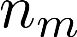
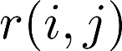
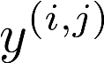
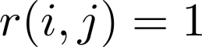
Example: Predicting movie ratings
User rates movies using one to five stars
Movie | Alice (1) | Bob (2) | Carol (3) | Dave (4)
Love at last
Romance forever
Cute puppies of love
Nonstop car chases
Swords vs. karate
= no. users
= no. movies
= 1 if user has rated movie
= rating given by user to movie (defined only if
)

Slide 69
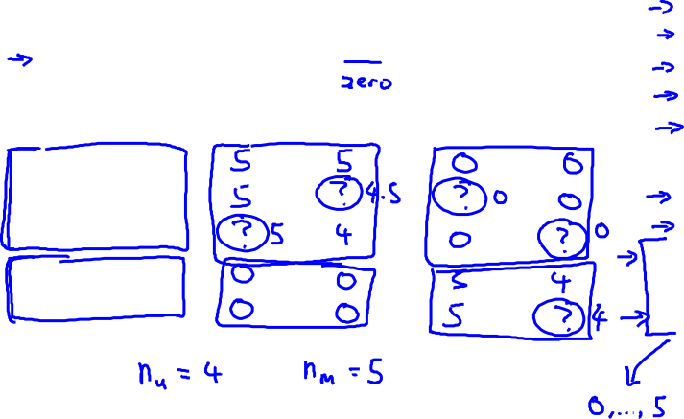
Example: Predicting movie ratings
User rates movies using one to five stars
Movie | Alice (1) | Bob (2) | Carol (3) | Dave (4)
Love at last
Romance forever
Cute puppies of love
Nonstop car chases
Swords vs. karate
= no. users
= no. movies
= 1 if user has rated movie
= rating given by user to movie (defined only if
)

Slide 70



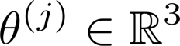

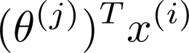
Content-based recommender systems
Movie | Alice (1) | Bob (2) | Carol (3) | Dave (4) | (romance) | (action)
Love at last | 5 | 5 | 0 | 0 | 0.9 | 0
Romance forever | 5 | ? | ? | 0 | 1.0 | 0.01
Cute puppies of love | ? | 4 | 0 | ? | 0.99 | 0
Nonstop car chases | 0 | 0 | 5 | 4 | 0.1 | 1.0
Swords vs. karate | 0 | 0 | 5 | ? | 0 | 0.9
For each user , learn a parameter . Predict user as rating movie with stars.
Notes:
Add dots

Slide 71
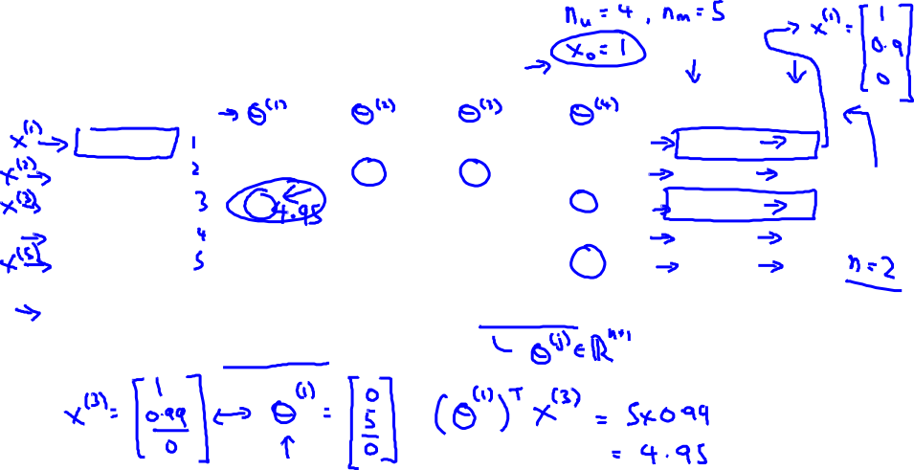
Content-based recommender systems
Movie | Alice (1) | Bob (2) | Carol (3) | Dave (4) | (romance) | (action)
Love at last | 5 | 5 | 0 | 0 | 0.9 | 0
Romance forever | 5 | ? | ? | 0 | 1.0 | 0.01
Cute puppies of love | ? | 4 | 0 | ? | 0.99 | 0
Nonstop car chases | 0 | 0 | 5 | 4 | 0.1 | 1.0
Swords vs. karate | 0 | 0 | 5 | ? | 0 | 0.9
For each user , learn a parameter . Predict user as rating movie with stars.
Notes:
Add dots

Slide 72
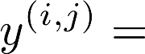
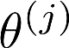
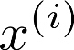
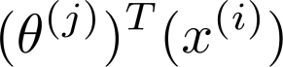
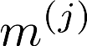
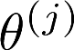
Problem formulation
if user has rated movie (0 otherwise)
rating by user on movie (if defined)
= parameter vector for user
= feature vector for movie
For user , movie , predicted rating:
= no. of movies rated by user
To learn :

Slide 73
Problem formulation
if user has rated movie (0 otherwise)
rating by user on movie (if defined)
= parameter vector for user
= feature vector for movie
For user , movie , predicted rating:
= no. of movies rated by user
To learn :

Slide 74
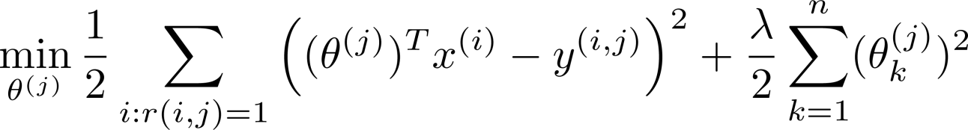
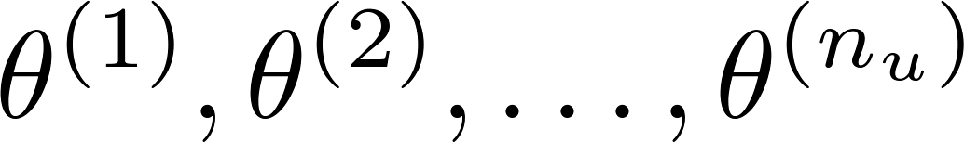

Optimization objective:
To learn (parameter for user ):
To learn :

Slide 75

Optimization algorithm:
Gradient descent update:

Slide 76
Optimization algorithm:
Gradient descent update:

Slide 77
Problem motivation – back to collaborative filtering
Movie | Alice (1) | Bob (2) | Carol (3) | Dave (4) | (romance) | (action)
Love at last | 5 | 5 | 0 | 0 | 0.9 | 0
Romance forever | 5 | ? | ? | 0 | 1.0 | 0.01
Cute puppies of love | ? | 4 | 0 | ? | 0.99 | 0
Nonstop car chases | 0 | 0 | 5 | 4 | 0.1 | 1.0
Swords vs. karate | 0 | 0 | 5 | ? | 0 | 0.9
Notes:
Change numbers to LATEX as well

Slide 78

Problem motivation
Movie | Alice (1) | Bob (2) | Carol (3) | Dave (4) | (romance) | (action)
Love at last | 5 | 5 | 0 | 0 | ? | ?
Romance forever | 5 | ? | ? | 0 | ? | ?
Cute puppies of love | ? | 4 | 0 | ? | ? | ?
Nonstop car chases | 0 | 0 | 5 | 4 | ? | ?
Swords vs. karate | 0 | 0 | 5 | ? | ? | ?
Notes:
Change numbers to LATEX as well

Slide 79
Problem motivation
Movie | Alice (1) | Bob (2) | Carol (3) | Dave (4) | (romance) | (action)
Love at last | 5 | 5 | 0 | 0 | ? | ?
Romance forever | 5 | ? | ? | 0 | ? | ?
Cute puppies of love | ? | 4 | 0 | ? | ? | ?
Nonstop car chases | 0 | 0 | 5 | 4 | ? | ?
Swords vs. karate | 0 | 0 | 5 | ? | ? | ?
Notes:
Change numbers to LATEX as well

Slide 80





Optimization algorithm
Given , to learn :
Given , to learn :

Slide 81
Collaborative filtering
Given (and movie ratings),
can estimate
Given ,
can estimate

Slide 82


Collaborative filtering optimization objective
Given , estimate :
Given , estimate :
Minimizing and simultaneously:

Slide 83



Collaborative filtering algorithm
Initialize to small random values.
Minimize using gradient descent (or an advanced optimization algorithm). E.g. for every :
For a user with parameters and a movie with (learned) features , predict a star rating of .

Slide 84

Collaborative filtering
Movie | Alice (1) | Bob (2) | Carol (3) | Dave (4)
Love at last | 5 | 5 | 0 | 0
Romance forever | 5 | ? | ? | 0
Cute puppies of love | ? | 4 | 0 | ?
Nonstop car chases | 0 | 0 | 5 | 4
Swords vs. karate | 0 | 0 | 5 | ?
Notes:
Make points have 0 mean on x1 and x2

Slide 85

Collaborative filtering - vectorization
Predicted ratings:
Notes:
Make points have 0 mean on x1 and x2

Slide 86


Finding related movies
For each product , we learn a feature vector .
How to find movies related to movie ?
5 most similar movies to movie :
Find the 5 movies with the smallest .
Notes:
Make points have 0 mean on x1 and x2

Slide 87
Finding related movies
For each product , we learn a feature vector .
How to find movies related to movie ?
5 most similar movies to movie :
Find the 5 movies with the smallest .
Notes:
Make points have 0 mean on x1 and x2

Slide 88


Users who have not rated any movies – mean normalization
Movie | Alice (1) | Bob (2) | Carol (3) | Dave (4) | Eve (5)
Love at last | 5 | 5 | 0 | 0 | ?
Romance forever | 5 | ? | ? | 0 | ?
Cute puppies of love | ? | 4 | 0 | ? | ?
Nonstop car chases | 0 | 0 | 5 | 4 | ?
Swords vs. karate | 0 | 0 | 5 | ? | ?

Slide 89




Mean Normalization:
For user , on movie predict:
User 5 (Eve):

Slide 90
Mean Normalization:
For user , on movie predict:
User 5 (Eve):

Slide 91
References
Trevor Hastie, Robert Tibshirani, Jerome Friedman. The Elements of Statistical Learning: Data Mining, Inference, and Prediction. Second Edition, 2009.
Anand Rajaraman, Jeffrey D. Ullman. Mining of Massive Datasets. 2009.
Toby Seagram, Collective Intelligence. 2007.
Recommending And Evaluating Choices In A Virtual Community Of Use. Will Hill, Larry Stead, Mark Rosenstein and George Furnas, Bellcore; CHI 1995.
Andrew Ng, Standford
William W. Cohen, CMU

